Slide 1
Smart Assistant for the Visually Impaired
Made By:
Shreayan Chaudhary (RA1611020010011)
Paras Sibal (RA1611020010055)
Ankit Sahu (RA1611020010095)

Slide 2
USE CASE DIAGRAMS

Slide 3
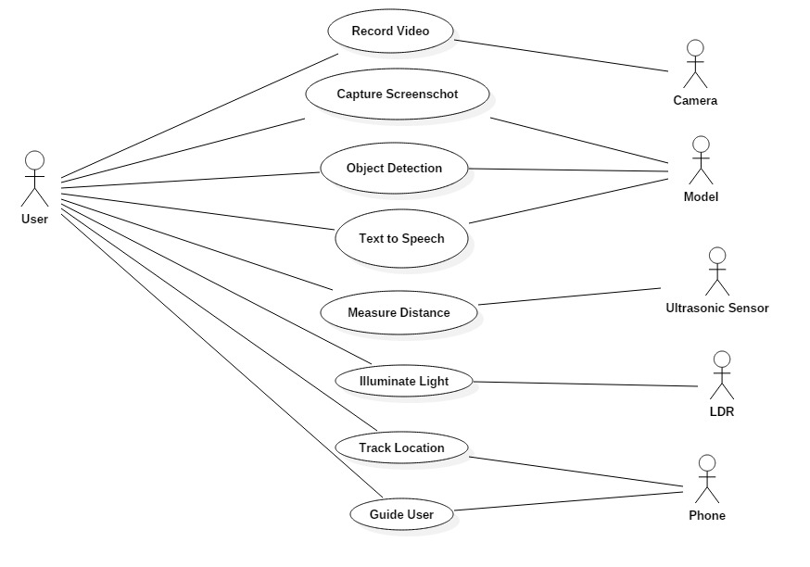
Headband usecases

Slide 4
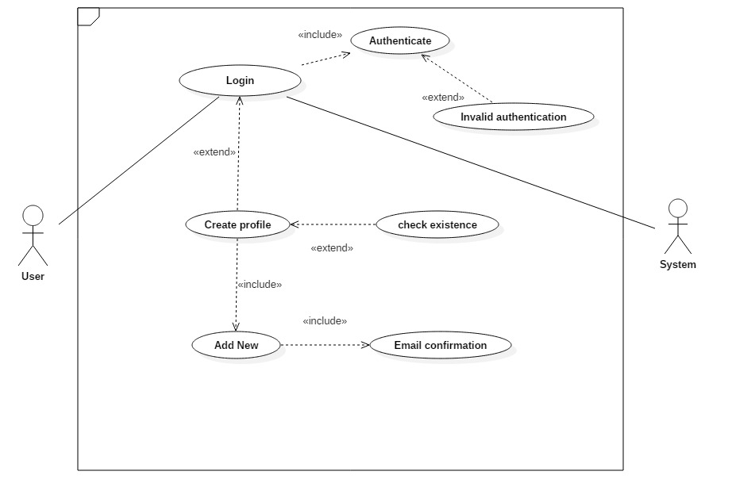
Usecase for authentication of user's profile

Slide 5
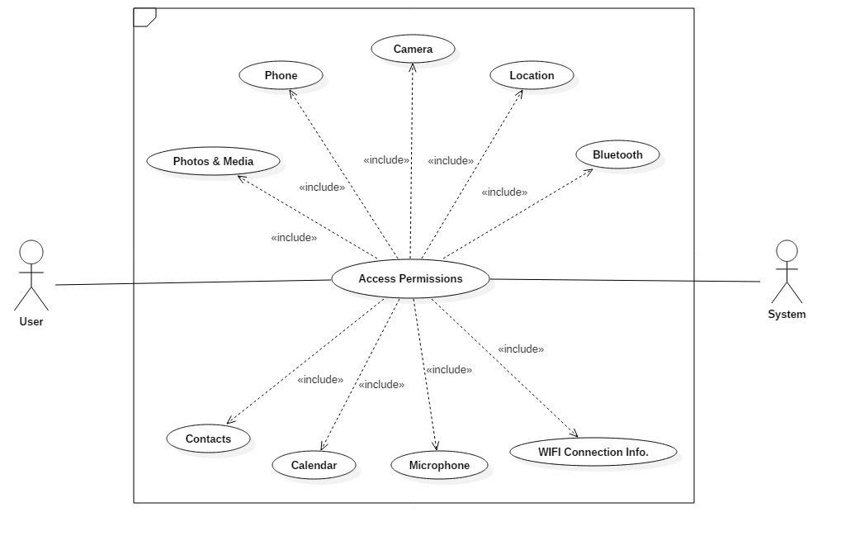
Headband permissions usecases

Slide 6
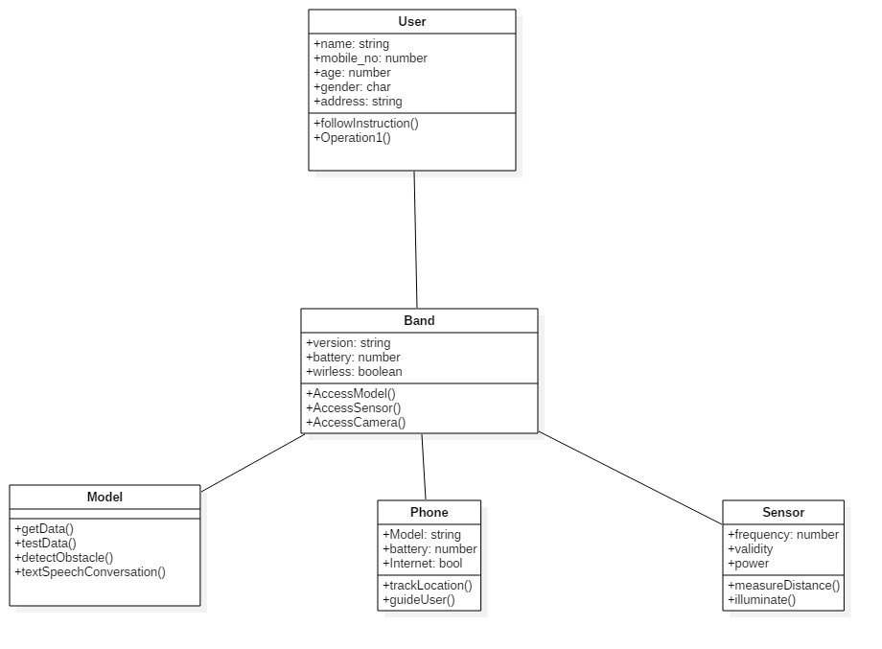
CLASS DIAGRAM

Slide 7
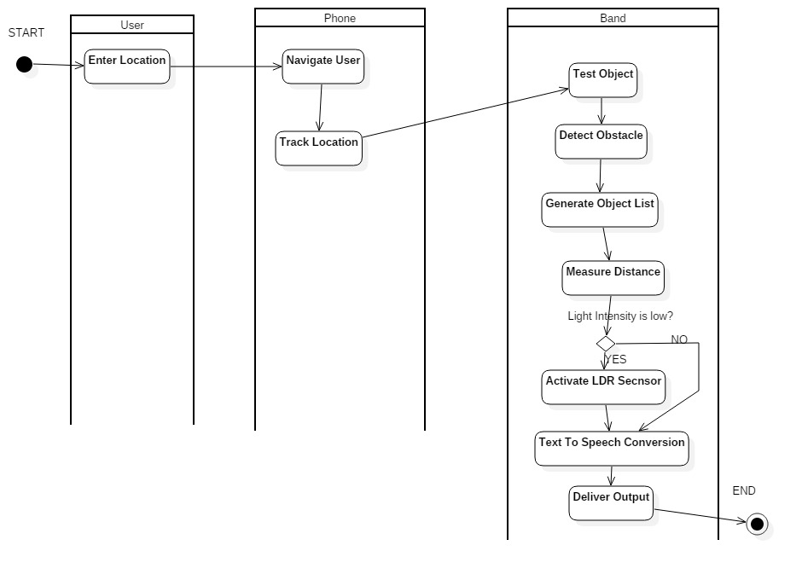
ACTIVITY DIAGRAM

Slide 8
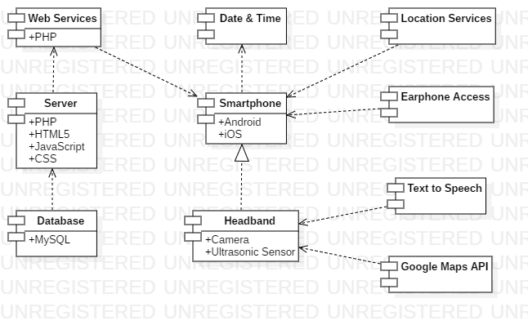
COMPONENT DIAGRAM

Slide 9
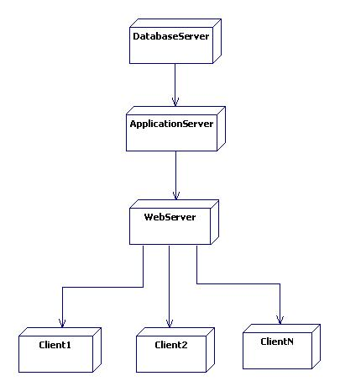
DEPLOYMENT DIAGRAM

Slide 10
THANK YOU

